Slide 1
Week 2 Checkerboard Assignment
Shane Pratt
EMBD.X424
AI-Driven Embedded Systems

Slide 2
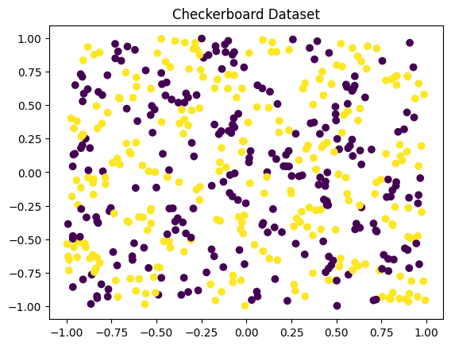
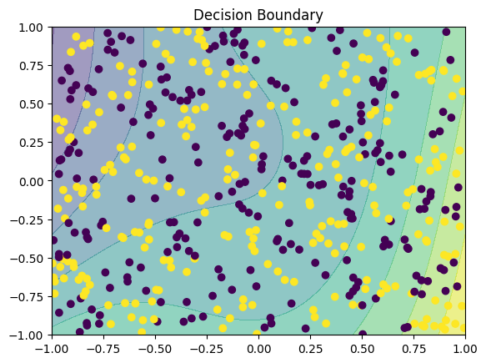
Gemini – Checkerboard
Notes:
Hidden size = 8
LR = 0.1
Epochs = 1000

Slide 3
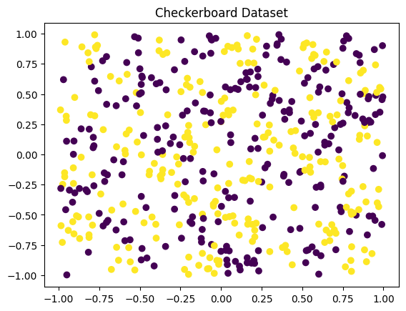
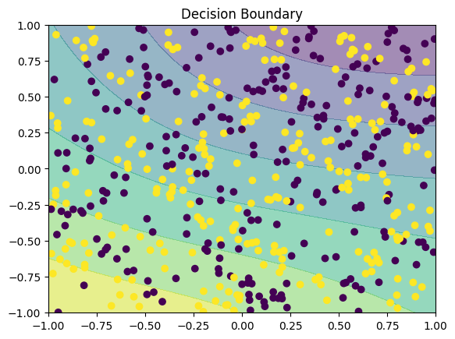
Claude – Checkerboard
Notes:
Hidden size = 16
LR = 0.1
Epochs = 2000

Slide 4
Gemini vs Claude – Checkerboard
Gemini
Claude
Hidden size = 8
LR = 0.1
Epochs = 1000
Hidden size = 16
LR = 0.1
Epochs = 2000

Slide 5
Gemini vs Claude - Loss
Gemini
Epoch 0, Loss: 1.1583
Epoch 100, Loss: 0.6985
Epoch 200, Loss: 0.6954
Epoch 300, Loss: 0.6939
Epoch 400, Loss: 0.6931
Epoch 500, Loss: 0.6927
Epoch 600, Loss: 0.6924
Epoch 700, Loss: 0.6923
Epoch 800, Loss: 0.6922
Epoch 900, Loss: 0.6922
Claude
Epoch 0, Loss: 0.7141
Epoch 100, Loss: 0.6896
Epoch 200, Loss: 0.6887
Epoch 300, Loss: 0.6885
Epoch 400, Loss: 0.6885
Epoch 500, Loss: 0.6885
Epoch 600, Loss: 0.6885
Epoch 700, Loss: 0.6884
Epoch 800, Loss: 0.6884
Epoch 900, Loss: 0.6884
Epoch 1000, Loss: 0.6884
Epoch 1100, Loss: 0.6883
Epoch 1200, Loss: 0.6883
Epoch 1300, Loss: 0.6883
Epoch 1400, Loss: 0.6883
Epoch 1500, Loss: 0.6882
Epoch 1600, Loss: 0.6882
Epoch 1700, Loss: 0.6882
Epoch 1800, Loss: 0.6882
Epoch 1900, Loss: 0.6881

Slide 6
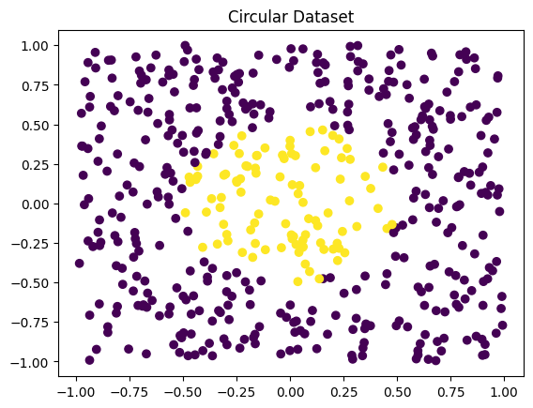
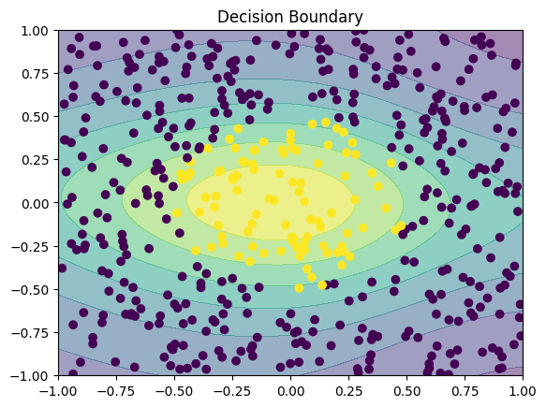
Gemini – Circular
Notes:
Hidden size = 8
LR = 0.1
Epochs = 2000

Slide 7
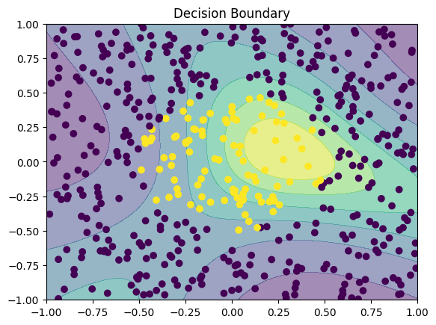
Gemini – Circular (ReLU Hidden Layer)
Notes:
Sigmoid activation function still used on output
ReLU are often preferred for hidden layers due to their computational efficiency and ability to mitigate the vanishing gradient problem.
Hidden size = 32
LR = 0.1
Epochs = 5000

Slide 8
Circular – Sigmoid vs ReLU
Sigmoid
Epoch 0, Loss: 0.5567
Epoch 100, Loss: 0.4927
Epoch 200, Loss: 0.4855
Epoch 300, Loss: 0.4810
Epoch 400, Loss: 0.4771
Epoch 500, Loss: 0.4731
Epoch 600, Loss: 0.4687
Epoch 700, Loss: 0.4638
Epoch 800, Loss: 0.4584
Epoch 900, Loss: 0.4525
Epoch 1000, Loss: 0.4462
Epoch 1100, Loss: 0.4393
Epoch 1200, Loss: 0.4320
Epoch 1300, Loss: 0.4244
Epoch 1400, Loss: 0.4164
Epoch 1500, Loss: 0.4081
Epoch 1600, Loss: 0.3995
Epoch 1700, Loss: 0.3908
Epoch 1800, Loss: 0.3819
Epoch 1900, Loss: 0.3729
ReLU
Epoch 0, Loss: 1.7391
Epoch 500, Loss: 0.1237
Epoch 1000, Loss: 0.0876
Epoch 1500, Loss: 0.0739
Epoch 2000, Loss: 0.0658
Epoch 2500, Loss: 0.0599
Epoch 3000, Loss: 0.0556
Epoch 3500, Loss: 0.0518
Epoch 4000, Loss: 0.0488
Epoch 4500, Loss: 0.0463
Epoch 4999, Loss: 0.0441

Slide 9
Questions
Why is this non-linear?
This is non-linear because the model cannot draw a perfectly straight line through the data points to classify them. Since the data set is based on a circle, the model needs to used a curve line for decisions.
Would a single-layer perceptron work?
No - A single-layer perceptron can only learn linearly separable patterns, which the circular classification model is not.
How would the decision boundary differ from the checkerboard?
The decision boundary for the circular classification fits the model better since there is a defined radius for data points. The checkerboard is a collection of boundaries made up of vertical and horizontal lines that it has to combine.

